Slide 1
Computing Fundamentals
“Where are we going, and why am I in this handbasket?” - Someone on The Internet (20th Century)
Notes:
1 min

Slide 2
What is “Computer Science” or “Computer Engineering”?
Computers hold great potential – but they’re complex.
We need to know what we can do – and the limits – computing.
There are many sub-areas within CSE:
Software design & development
Hardware design & development
Engineering process (“Software Engineering”)
Computational theory (mathematics, potential, and limitations)
Problem solving
“Computer science” and “computer engineering” are two sides of the same coin – science tells us how systems work together, and engineering is how we build them.
Notes:
2.5 min

Slide 3
Why do we need CS/CE?
People need things. “6 Harsh Truths That Will Make You a Better Person”, David Wong, Cracked.com (2012)
Computing has before, and can in the future, make the world a better place. “The Last Lecture”, Randy Pausch, CMU (2007) [YouTube link]
But we have be willing to set aside the “default setting” – and it’s hard. “This is Water”, David Foster Wallace, Little, Brown & Co. (2005-2009) [YouTube link]
Little of value is easy.… and you will fail, a lot. That’s OK! Be resilient and develop grit. (Ok, I’m done with the pep-talk now, I promise!)
Notes:
5 min

Slide 4
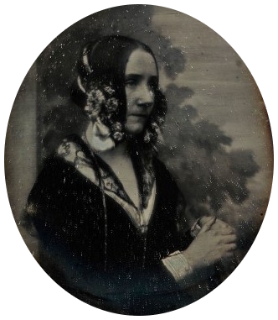
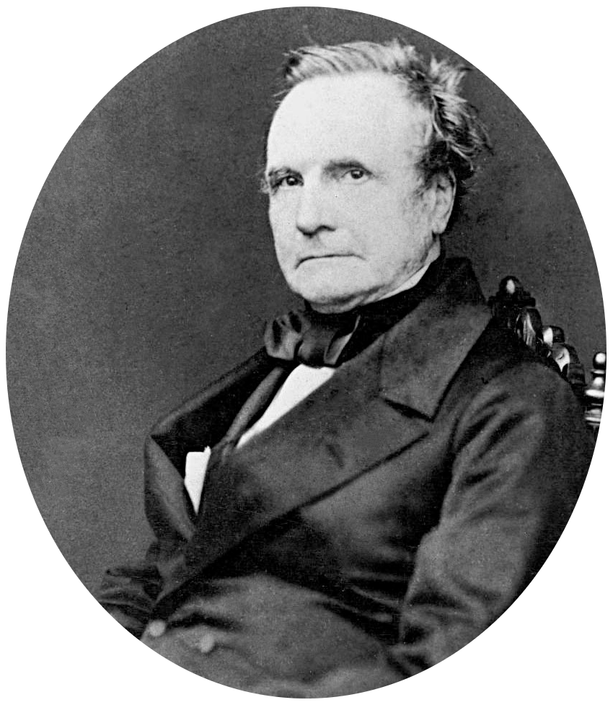
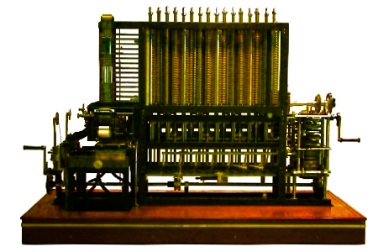
Old-Skool “Computers”
Computers were not always electrical…
“Computer” was a job title before the first machines
Charles Babbage designed the first computers (Difference & Analytical Engines)
Ada Lovelace is generally credited as the first programmer
Notes:
1.5 min

Slide 5
Looking Back Circa 1945
By most metrics, 1945 was well within the modern era:
Electricity
Running water
Telephones
Television
Air Travel
Modern Warfare
However, the first digital computer had yet to be completed.
Notes:
1.5 min

Slide 6
Looking Back What was Missing?
… but the world was a radically different place:
Complex Math: people (“computers”)
Repetitive Arithmetic: mechanical tabulating machines (IBM!)
Records: paper (written), vinyl (audio), or film (video) – and “lossy”
Communication: slow (post) or expensive (home phone if you’re lucky!)
Coordinating: set the meeting time and place well in advance
Travel: buy tickets at the station / dock with cash (only)
Commerce: Mail order catalog… order and pray!
Notes:
3.5 min

Slide 7
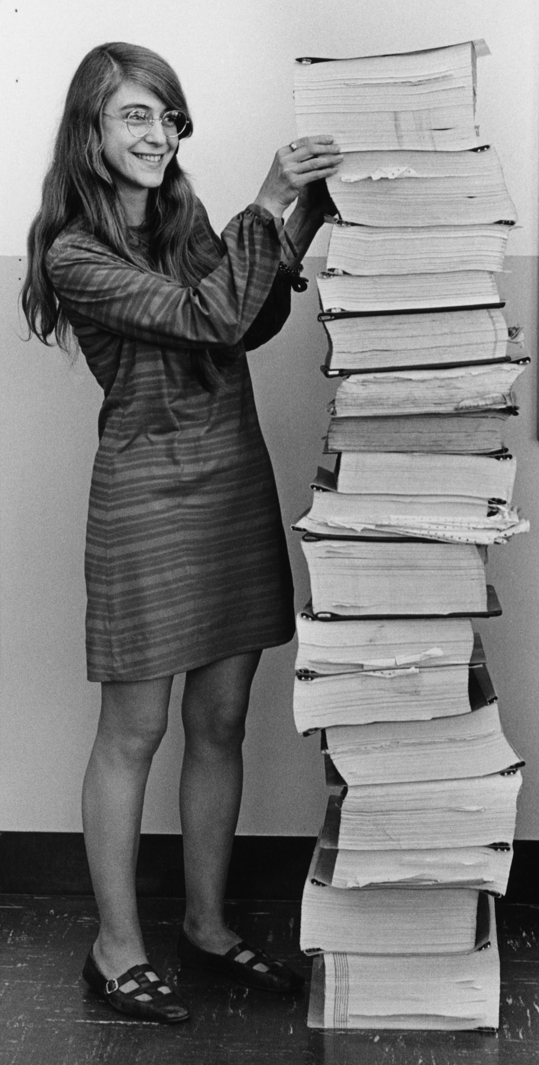
Early Computing
The first computers filled rooms & cost millions!
Shared computing was the norm
Lots and lots of paper (in and out)
Mistakes were costly!
Reserved for research and military…
Unless you were a railroad club “hacker” ☺
Notes:
2.5 min

Slide 8

Computing Today
Today, we have computing technology that is straight from Sci-Fi:
Smart phones (Star Trek)
Handheld sensors (Star Trek)
Smart Watch (The Jetsons)
Autonomous Vacuums (The Jetsons)
Video Chat (…The Jetsons)
AI Assistant (2001: A Space Odyssey)
Digital Billboards (Blade Runner)
Tablets (…also Star Trek)
Notes:
1 min

Slide 9
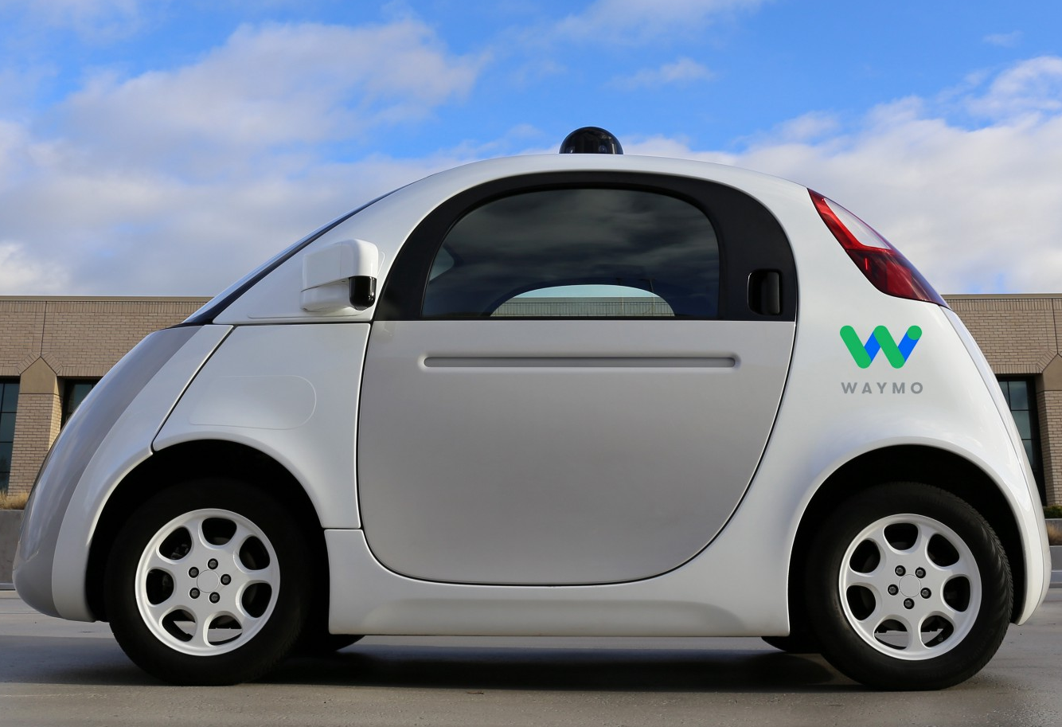
Looking Ahead What’s Next?
If I knew, I’d be rich! But the “good money” is in a few places…
Autonomous Vehicles (Total Recall)
Robust Voice Recognition (…Star Trek…)
Brain-Computer Interface (The Matrix)
Pervasive Augmented Reality (Denno Coil)
Robotic Prostheses / Organs (Nyctalope)
Edge computing (AKA IoT)
Drone delivery
Maybe these missing the mark… but the opportunities are there!
Notes:
2 min
(~20.5 min)

Slide 10
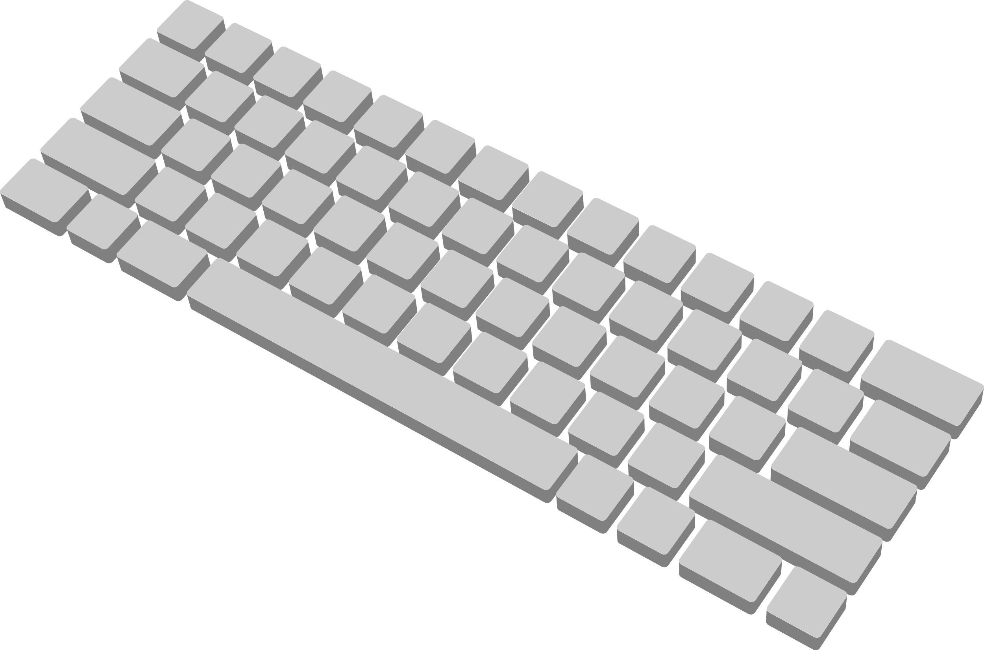


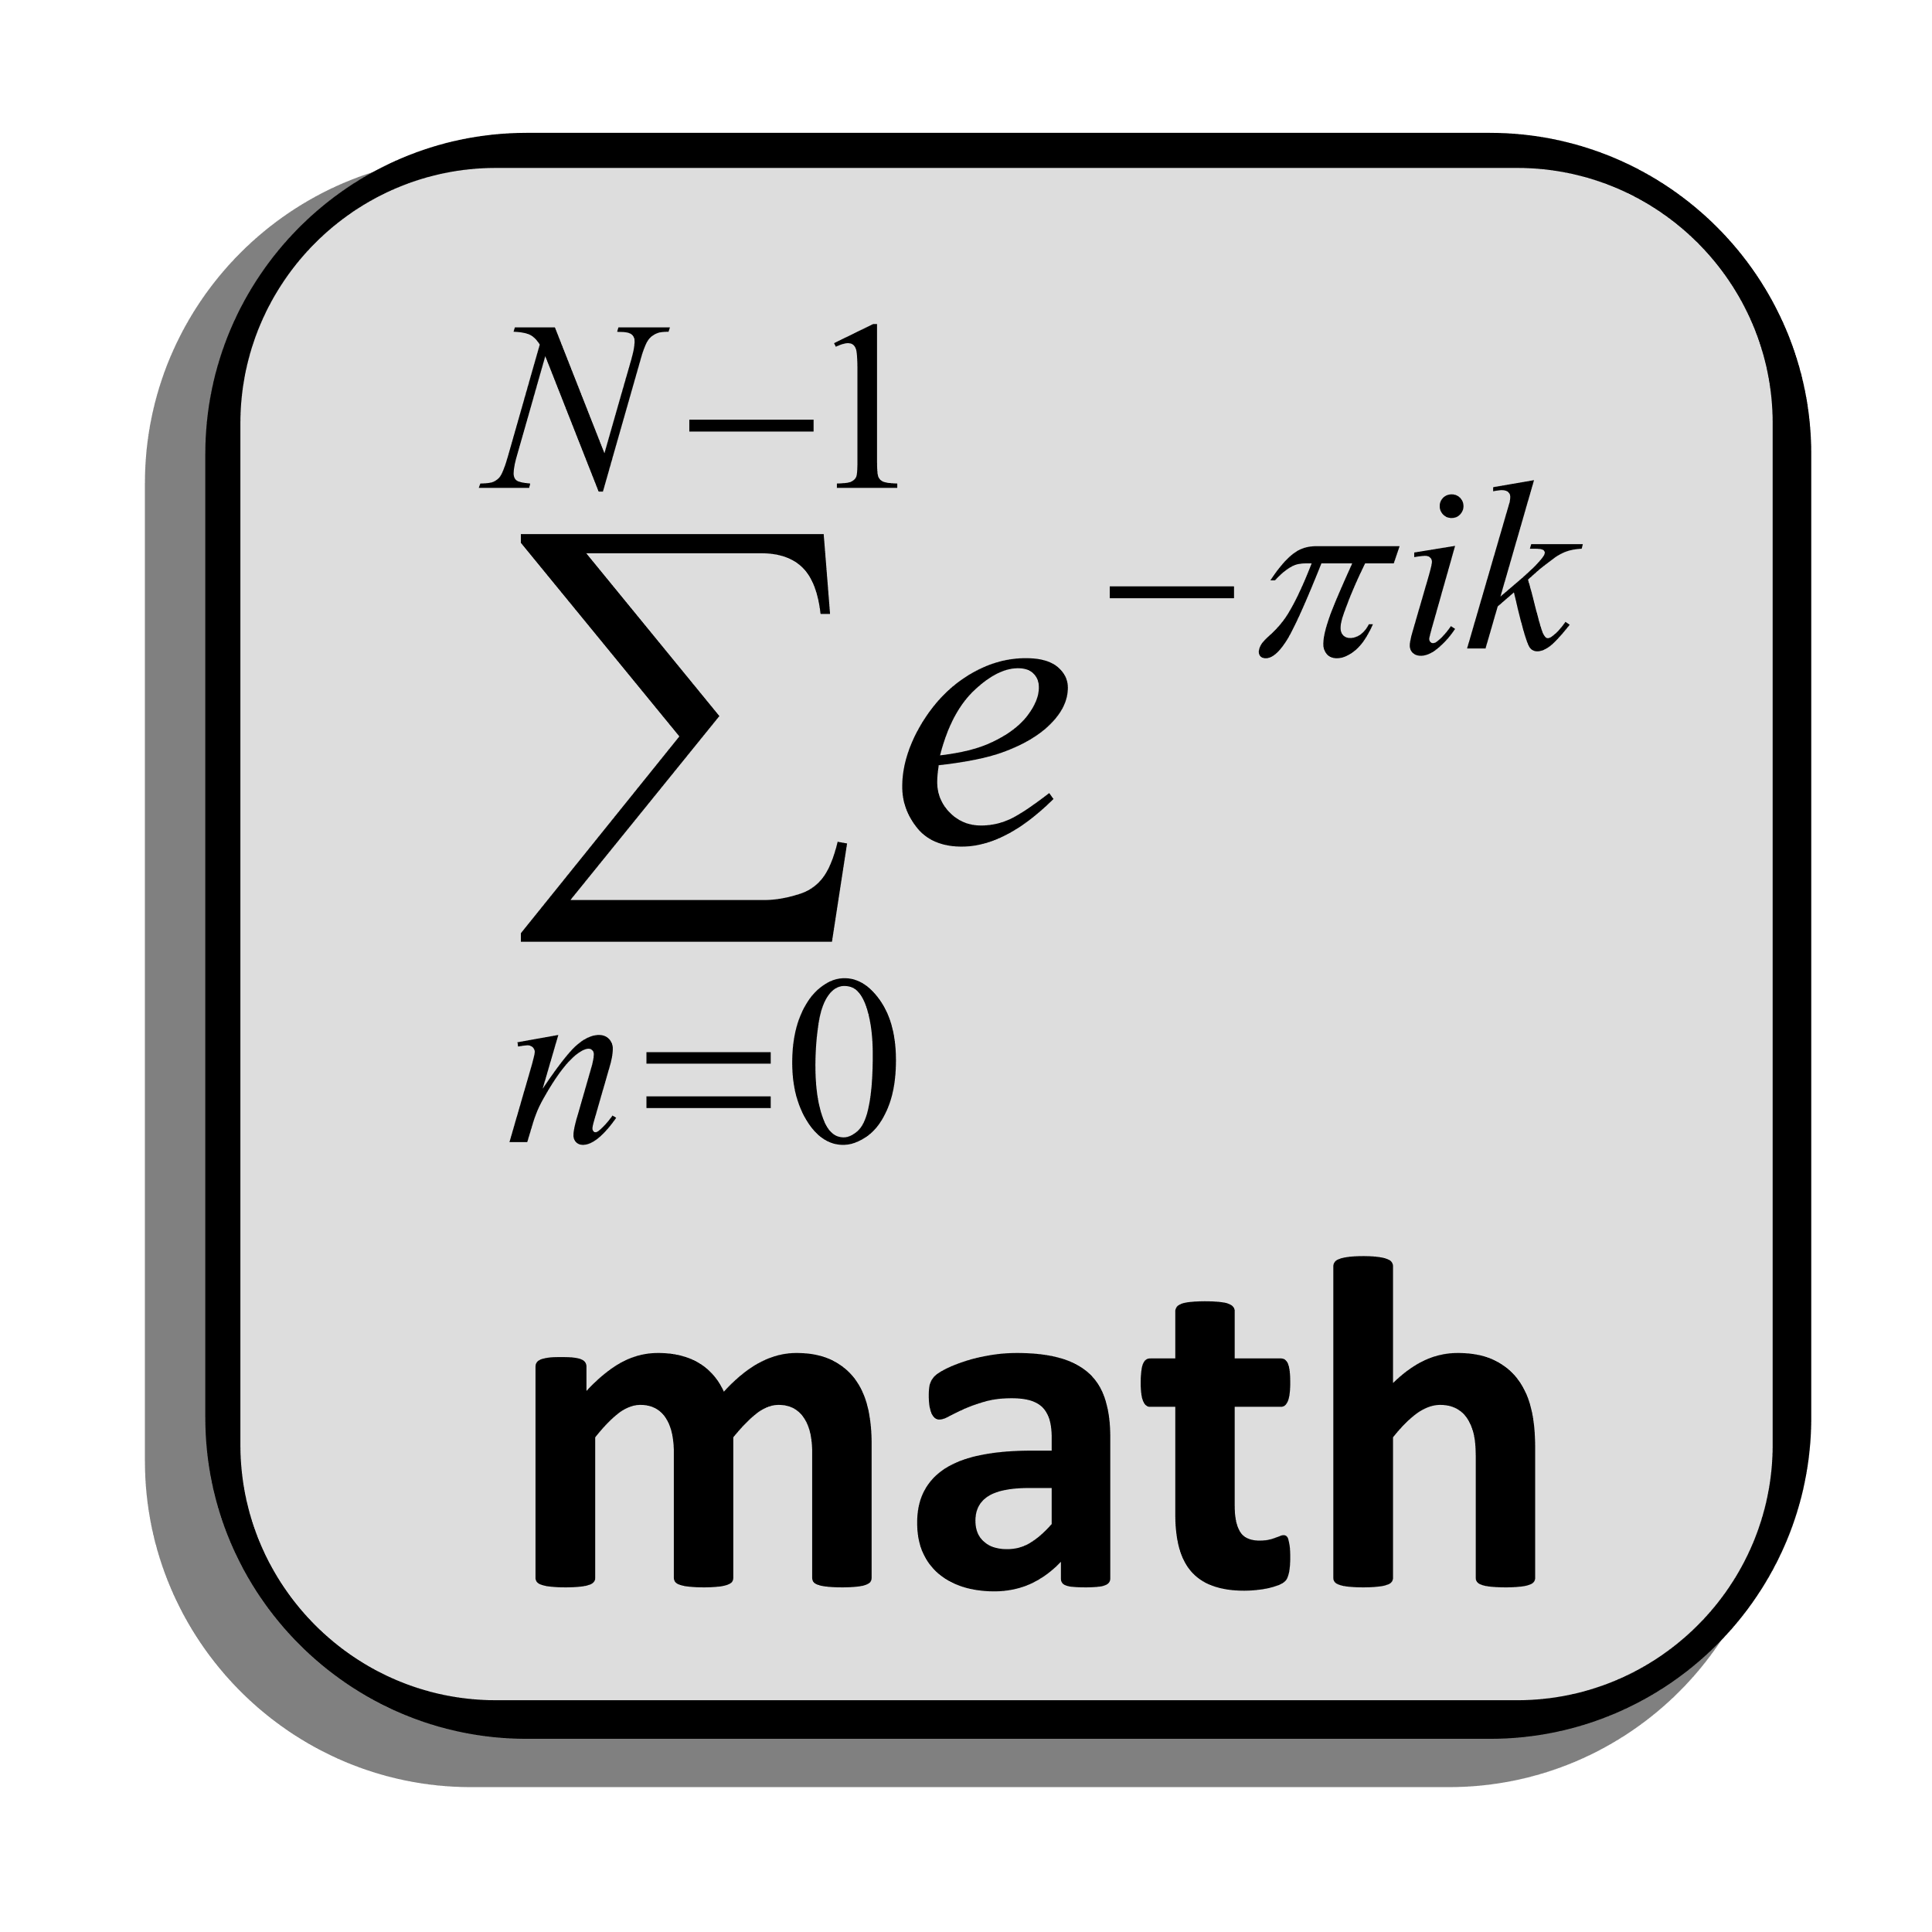
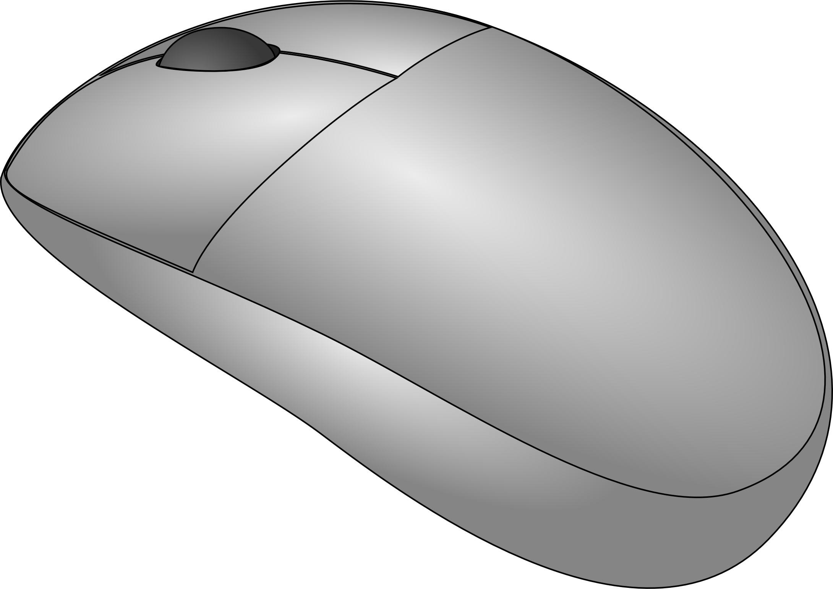





Computer: How does it “Do”?
At its core, a computer runs mathematical instructions. It’s a calculator!
Input
CPU
Memory
Output
Storage (I/O)
Information in modern digital computers is written and read in binary format.
Notes:
1.5 min

Slide 11

Programming
Every processor has a defined instruction set for its machine language (in binary).
Ye Olde Programme
01001011010010
11011101010101 0101000111000
0000111101010
1111011101010
010100010101
000011101011
A set of instructions together make up a program.
Notes:
2 min

Slide 12


Programming Languages
Most programming is done in human-readable programming languages.
In systems languages (C/C++/Rust), source code is often compiled into machine code.
Compiler
Ye Olde Machine Code
01001011010010
11011101010101 0101000111000
0000111101010
1110111010101
0101000101011
0000111010110
One Time
Every Time
Scripting languages are interpreted during execution rather than compiled.
Notes:
5 min

Slide 13
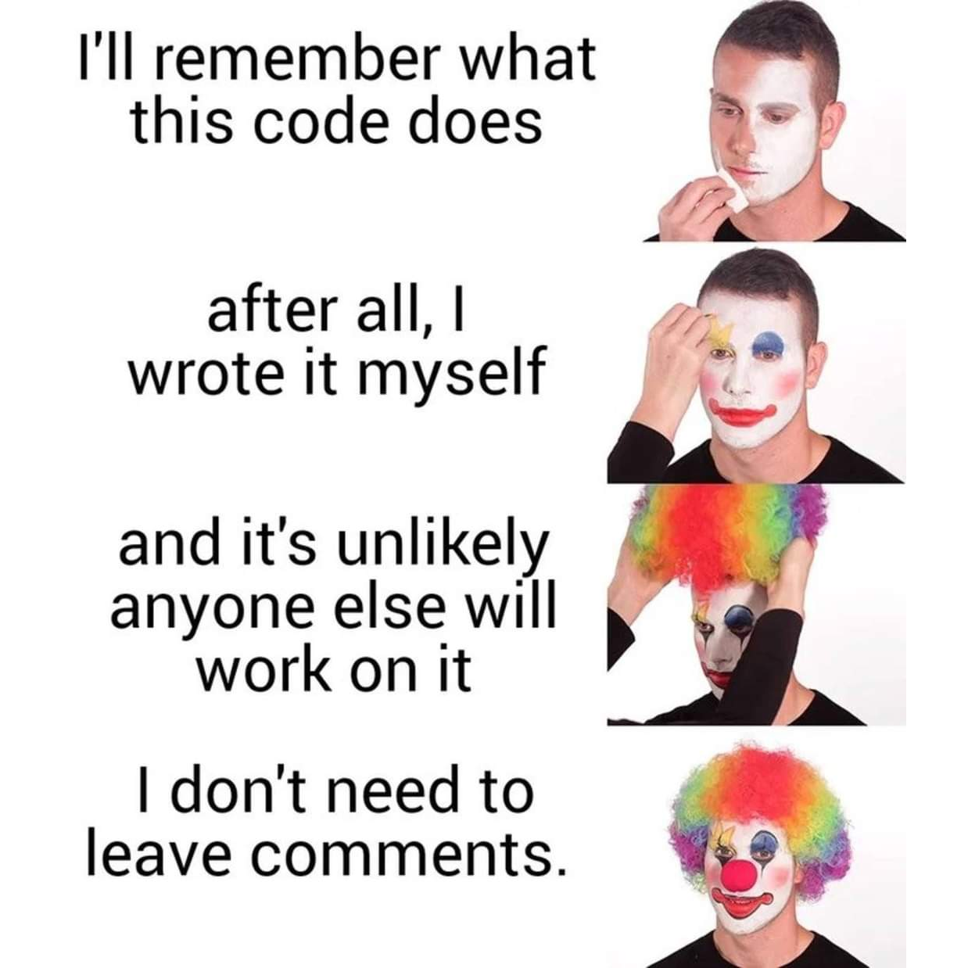
Comments – Why?
Comments are not compiled, but they are critical – they are there for other people, but also for yourself.
Leave out comments at your own peril. You may think you’ll remember – and sometimes you will – but often, you won’t.
We will penalize lack of comments! ☺
Notes:
1 min

Slide 14
The Importance of Citation
Cite code and other sources whenever you…
Get code from another source directly (copy-paste)
Read and are “inspired” by code
Implement an idea that comes from code or pseudo-code
Do not wholly create something completely on your own
But why?!
It’s just polite to give credit where it is due – see Wheaton’s Law
Because it is often illegal not to (see: licensing)
Because it will keep you from going to the Honor Court
Because I said so, and I’m smart and stuff
Notes:
3 min

Slide 15
How should I Cite Code?
However you practically can!
In comments (ALWAYS)
In documents (Almost always… and always for class assignments!)
In person (when you talk about code)
When you meet your extended relatives
Until you draw your final breath
Here’s a code example: /*************************************************************************************** * Title: <title of program/source code> * Author: <author(s) names> * Date: <date> * Code version: <code version> * Availability: <where it's located> * ***************************************************************************************/
More information: http://uark.libguides.com/CSCE/CitingCode
Notes:
1.5 min

Slide 16


Error Types
In programming, we deal with a few types of errors.
Syntax errors are errors in language grammar.
Spelling / punctuation / form
Result in compile-time errors
These are the easy ones!
→ “You misspelled antidisestablishmentarianism.”
Logic errors aren’t language issues; they are semantic.
What you said, not what you meant
Result in run-time errors
Most of our bugs are these.
→ “Put your shoes in the fridge.”
Notes:
2.5 min
~36 min

